Slide 1
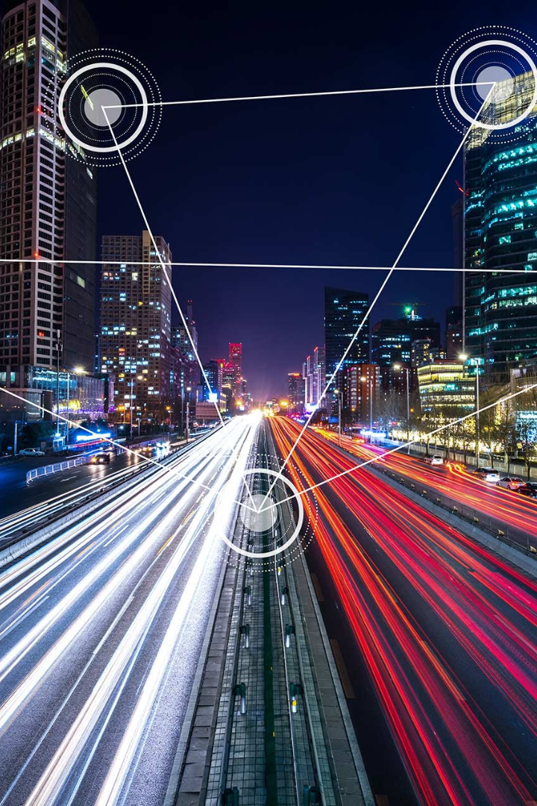
Traffic Management System in IoT
The internet of things (IoT) is revolutionizing the way we manage traffic. With real-time data collection, the system can adjust to changing situations, leading to safer and more efficient roads.

Slide 2
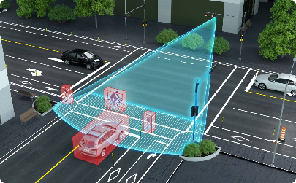
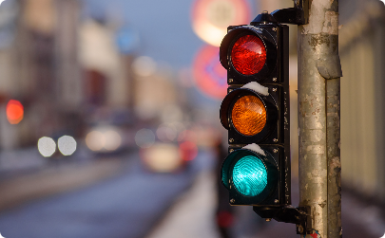
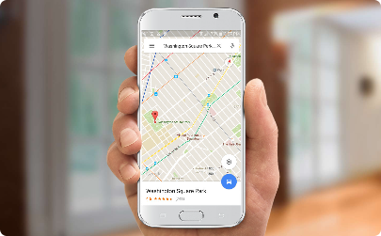
Key Components of the System
Sensors
Traffic Signals
Mobile Devices
The system relies on a network of sensors that detect traffic flow and patterns, allowing for real-time data collection.
The traffic signals are connected to the network and can be remotely controlled, allowing for optimal traffic flow and reduced congestion.
People can use mobile devices to stay informed about traffic conditions and to adjust their routes.

Slide 3
Data Collection and Processing
1
Data Collection
The system collects data from different sources, including traffic sensors, GPS, and other mobile devices. The data is sent to a central server for processing.
Data Processing
2
Advanced algorithms are used to analyze the data in real-time and to detect patterns and anomalies. The results are used to adjust traffic signals, change speed limits, or send alerts to drivers.
3
Data Visualization
The processed data is visualized on a dashboard, providing insights into traffic patterns and trends. The dashboard also allows for remote control of the system.

Slide 4
Real-time Monitoring and Control
Traffic Signal Control
Speed Limit Control
The system adjusts traffic signals in real-time to optimize traffic flow and reduce congestion.
The system can change speed limits based on traffic conditions, ensuring the safety of drivers and pedestrians.
Emergency Response
Dynamic Routing
The system can detect accidents or other emergencies and quickly alert first responders.
The system can provide real-time traffic information to drivers and suggest alternative routes to avoid congestion.

Slide 5

Benefits of IoT Traffic Management
1
Reduced Congestion
2
Safer Roads
3
Lower Emissions
The system can prevent accidents, detect hazards, and alert first responders in emergencies, leading to safer roads for everyone.
The system can reduce emissions by optimizing traffic flow and reducing congestion, leading to cleaner air and a healthier environment.
The system reduces traffic congestion and waiting times, leading to faster and more reliable driving times.

Slide 6
Challenges and Limitations
1
Data Privacy
The system relies on collecting data from different sources, raising concerns about data privacy and security.
Cost
2
The system requires significant investment in infrastructure and technology, making it challenging to implement on a large scale.
3
Maintenance
The system requires ongoing maintenance and monitoring, making it important to have a skilled workforce to manage and operate the system.

Slide 7
Future Developments and Potential Impact
Connected Vehicles
Smart Cities
Environmental Sustainability
The traffic management system is part of a larger trend towards creating smart cities, where technology is used to optimize urban infrastructure and services.
With the advent of connected and autonomous vehicles, the traffic management system can communicate directly with vehicles, providing real-time information and control.
The traffic management system can contribute to environmental sustainability by reducing emissions, promoting public transportation, and encouraging energy-efficient driving.

Slide 8
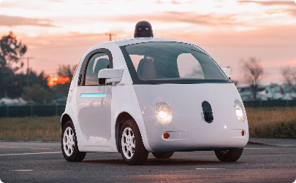

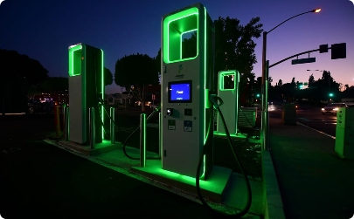
The Future is Here
Connected Cars
Smart Cities
Sustainability
Connected vehicles are the future of transportation, providing real-time data and enhanced safety features.
Smart cities empower technology to enhance the lives of urban residents and to create sustainable and efficient living spaces.
Sustainable transportation is the key to reducing emissions and promoting a cleaner and healthier environment for all.

